Slide 1
4 Transform-and-Conquer

Slide 2
Divide-and-conquer algorithms T(n) = aT(n/b) + f(n)
Decrease-and-Conquer
Exploiting and then establishing the relationship between
a solution to a given instance of a problem and
a solution to a smaller instance of the same problem.
Three major variations of decrease-and-conquer:
Decrease by a constant. Insertion sort, Topological sorting (DFS). T(n) = T(n - c) + f(n)
Decrease by a constant factor. Binary Search, Russian peasant multiplication, fake coin problem. T(n) = T(n/b) + f(n)
Variable size decrease. Euclid’s algorithm, the partition-based algorithm for interpolation search, and searching and insertion in a binary search tree..
review

Slide 3

Transform-and-Conquer
Design methods based on the idea of transformation.
Two-stage procedures:
In the transformation stage,
modify the problem’s instance to be more amenable to solution, for some reasons.
In the conquering stage,
it is solved.

Slide 4
Transform-and-Conquer
Transform-and-conquer strategy:
simpler instance
or
Problems’ another representation solution
instance or
another problem’s instance
(problem reduction)
transformation stage conquering stage

Slide 5
Transform-and-Conquer
Three major variations by what we transform a given problem’s instance to:
instance simplification - transformation to a simpler instance of the same problem.
representation change – transformation to a different representation of the same instance.
Problem reduction – transformation to an instance of a different problem for which an algorithm is already available.

Slide 6
Transform-and-Conquer
Instance Simplification:
Presorting is used to sort inputs for many algorithmic problems that become easier to solve.
Examples: illustrate instance simplification, using presorting
Algorithm PresortElementUniqueness(A[0 .. n-1]) for checking element uniqueness in an array .
Reduce T(n) = Θ(n²) to T(n) = Θ(nlog n) + Θ(n).
Algorithm PresortMode(A[0 .. n-1]) for Computing a mode.
Reduce T(n) = Θ(n² ) to T(n) = Θ(nlog n) + Θ(n).
Searching problem for a given value v in a given array of n sortable items.
Increase T(n) = Θ (n) to T(n) = Θ(nlog n) + Θ(log n.)

Slide 7
Transform-and-Conquer
Representation Changes
Examples of the representation change.
Gaussian elimination solves a system of linear equations:
transform it to another system that makes finding a solution easier.
Balanced Search Trees, including AVL trees:
transform an unbalanced binary tree to a binary search tree (also considered to be an instance simplification)
Heaps and heapsort, Horner’s rule and Binary Exponentiation

Slide 8
Transform-and-Conquer
Problem Reduction:
Examples are
Computing the Least Common Multiple,
Counting paths between two vertices in a graph,
Finding functions’ Maximization and Minimization problems,
Linear Programming (Investment and Knapsack problems).
Reduction to Graph Problems

Slide 9

Transform-and-Conquer - Instance Simplification
Presorting - Technique used for simplify instances
For the simplicity’s sake, assume that lists are implemented as arrays.
Three elementary sorting algorithms:
Selection sort -
Bubble sort, and
Insertion sort
Their time taken is quadratic, Θ(n²), in the worst and average cases.
Best sorting algorithms:
Mergesort (always in Θ(n log n)), and
Quicksort, (also Θ(n log n) in the average case but is quadratic Θ(n²) in the worst case).

Slide 10
Transform-and-Conquer - Instance Simplification
Are there any faster sorting algorithms?
No general comparison-based sorting algorithm can have a better efficiency than nlog n in the worst case.
And the same result (nlog n) holds for average-case efficiency.

Slide 11
Transform-and-Conquer - Instance Simplification
Examples of Instance Simplification:
Consider instance simplification
transformation to a simpler or more convenient instance of the same problem.
Presorting
sort inputs first for many algorithmic problems that become easier to solve.

Slide 12

Transform-and-Conquer - Instance Simplification
Example 1: Checking element uniqueness in an array
The brute-force algorithm:
compared pairs of the array’s elements until
either two equal elements were found
or no more pairs were left.
Its worst-case efficiency is in Θ(n²).
Alternatively, presorting in Instance Simplification
sort the array first and then check only its consecutive elements:
if the array has equal elements, a pair of them just be next to each other and vice versa.
Its efficiency is Θ(n log n) + Θ(n)

Slide 13
Transform-and-Conquer - Instance Simplification
Algorithm PresortElementUniqueness(A[0 .. n-1])
//Solves the element uniqueness problem by sorting the array first
//Input: An array A[0 .. n-1] of orderable elements
//Output: Returns “true” if A has no equal elements,
// “false” otherwise.
sort the array A;
i ← 0;
while (i ≤ n – 2) do {
//there are the same elements
if A[ i ] = A[ i + 1] return false;
i ← i +1; } //end of while
return true; //it is uniqueness.

Slide 14
Transform-and-Conquer - Instance Simplification
Analysis of efficiency of the algorithm:
The running time of this algorithm is the sum of
Time spent on sorting:
Use a good sorting algorithm, such as mergesort;
sorting requires at least (nlog₂ n) comparisons and,
time efficiency for the worst-case is Θ(n log₂ n).
Time spent on checking consecutive elements:
Then, checking consecutive elements needs no more than (n – 1) comparisons.
The sorting part determines the algorithm’s overall efficiency:
T(n) = T_{sort} (n) + T_{scan} (n)
ε Θ(nlog n) + Θ(n)
= Θ(nlog n).

Slide 15
Transform-and-Conquer - Instance Simplification
Example 2: Computing a mode
A mode – the element (value) that occurs most often in a given list of
orderable elements.
If several different elements (values) has a tie occurrence, any of them can be considered a mode.
For example:
Given a list {5, 1, 5, 7, 6, 5, 7}, the mode is 5.
The brute-force approach to computing a mode would be:
scan the list and
compute the frequencies of all its distinct elements (values),
then find the element (value) with the largest frequency.

Slide 16
Transform-and-Conquer - Instance Simplification
To implement this idea,
Store the elements (values) already encountered, along with their frequencies, in a separate auxiliary-list.
On each iteration,
Compare the i^{th} element of the given list with the elements (values) already encountered by traversing this auxiliary-list.
if a matching element (value) is found, increment its frequency;
else add the current element to the auxiliary-list of distinct elements (values) seen so far with a frequency of 1.

Slide 17










Transform-and-Conquer - Instance Simplification
A brute force approach:
Given a list of integer elements.
5 | 1 | 5 | 7 | 6 | 5 | 7 |  | . | . | .
The history of an auxiliary list of (element, frequency)-pairs.
5 | 1 |  | 5 | 1 |  | 5 | 2 |  | 5 | 2 |  | 5 | 2 |  | 5 | 3 |  | 5 | 3
 |  |  | 1 | 1 |  | 1 | 1 |  | 1 | 1 |  | 1 | 1 |  | 1 | 1 |  | 1 | 1
 |  |  |  |  |  |  |  |  | 7 | 1 |  | 7 | 1 |  | 7 | 1 |  | 7 | 2
 |  |  |  |  |  |  |  |  |  |  |  | 6 | 1 |  | 6 | 1 |  | 6 | 1
$$→$$
$$→$$
$$→$$
$$→$$
$$→$$
$$→$$
$$→$$
$$→$$
$$→$$
$$→$$

Slide 18
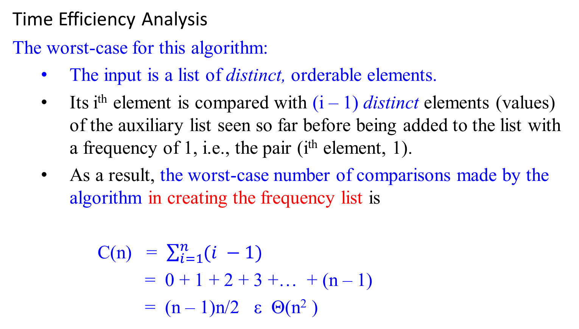
Transform-and-Conquer - Instance Simplification
Time Efficiency Analysis
The worst-case for this algorithm:
The input is a list of distinct, orderable elements.
Its i^{th} element is compared with (i – 1) distinct elements (values) of the auxiliary list seen so far before being added to the list with a frequency of 1, i.e., the pair (i^{th} element, 1).
As a result, the worst-case number of comparisons made by the algorithm in creating the frequency list is
C(n) = $\sum_{i=1}^{n}{(i −1)}$
= 0 + 1 + 2 + 3 +… + (n – 1)
= (n – 1)n/2 ε Θ(n² )

Slide 19
Transform-and-Conquer - Instance Simplification
Time Efficiency Analysis
The worst-case for this algorithm:
…
Additional (n – 1) comparisons is needed for finding the largest frequency in the auxiliary list.
T_{scan} (n) = Θ(n).
Time efficiency for this brute force algorithm is:
T(n) = T_{C(n)} (n) + T_{scan} (n)
= Θ(n² ) + Θ(n)
= Θ(n² ).
The algorithm is of the quadratic worst-case efficiency class.

Slide 20
Transform-and-Conquer - Instance Simplification
As an alternative (Instance Simplification using Presorting),
First sort the input list of orderable elements.
Then all identical (i.e., indistinct) elements (values) will be adjacent to each other.
To compute the mode, all need to do is
to find the longest run of adjacent identical elements (values) in the sorted array.

Slide 21
Transform-and-Conquer - Instance Simplification
Algorithm PresortMode(A[0 .. n-1])
//computes the mode of an array by sorting it first.
//Input: An array A[0 .. n-1] of orderable elements
//Output: The array’s mode
sort the array A;
i ← 0; //current run begins at position i.
modefrequency ← 0; //highest frequency seen so far.
while (i ≤ n-1) do { //go through A[0] through A[n-1]
runlength ← 1; //reset identical contents# be 1 as itself
runvalue ← A[i]; //set A[i] content as a new sequence
//ask whether the next A[i+1], A[i+2], ... is identical to A[i]. If yes, ident.cont#++
while ( i + runlength ≤ n-1 & A[i+runlength] = = runvalue ) do {
runlength ← runlength + 1; } //end inner while-do
//if this identical contents# greater than existing modefreq, then set new modefreq.
if (runlength > modefrequency)
{ modefrequency ← runlength;
modevalue ← runvalue; } //end if
//set the new content A[i+modefrequency] as next runvalue. Repeat the same process.
i ← i + runlength; } //end outer while-do
return modevalue;

Slide 22

Transform-and-Conquer - Instance Simplification
5 | 1 | 5 | 7 | 6 | 5 | 7 | …
$$↓$$
1 | 5 | 5 | 5 | 6 | 7 | 7 | …

Slide 23
Transform-and-Conquer - Instance Simplification
The algorithm analysis
It is similar to the analysis of Example 1:
The running time of the Algorithm PresortMode(A[0 .. n-1])
will be dominated by the time spent on sorting
Since the remainder of the algorithm takes linear time (why?).
Given a list of n distinct elements in A[0..n-1],
the inner while-loop compares A[i] and A[i+1], 0 ≤ i ≤ n-2
That is, the basic operation A[i+runlength] = runvalue will be executed n times only.

Slide 24
Transform-and-Conquer - Instance Simplification
Given a list of n mix-identical elements in A[0..n-1], say 3, 3, 4, 5, 5, 5, 6, 7, 7, 7...
increase i by runlength (which is the number of identical elements).
Let C(n) be the sum of runlength per each distinct element of a given list. For 3, 3, 4, 5, 5, 5, 6, 7, 7, 7 C(n) = 2₃ + 1₄ + 3₅ + 1₆ + 3₇ = 10. That is, C(n) = Θ(n).
Thus, with an Θ (nlog n) sort, this algorithm’s worst-case is in an asymptotic class,
T(n) = T_{Sort} (n) + T_{C(n)} (n)
= Θ(nlog n ) + Θ(n)
= Θ(nlog n )
This is better than the worst case efficiency of the brute-force algorithm, which is Θ(n² ).

Slide 25
Transform-and-Conquer - Instance Simplification
Example 3 : Searching problem
Consider the problem of searching a given array of n orderable items for a given key K.
The brute-force solution is
sequential search needs n comparisons in the worst case.
If the array is sorted first, then apply binary search.
Binary search requires └log₂n ┘+1 comparisons in the worst case.
But, with the most efficient nlog₂n sort,
he total running time of searching algorithm in the worst case is
T(n) = T_{sort}(n) + T_{search}(n)
= Θ(nlog n) + Θ(log n)
= Θ(nlog n)
This is inferior to sequential search - Θ(n).
The same is also true for the average-case efficiency.

Slide 26
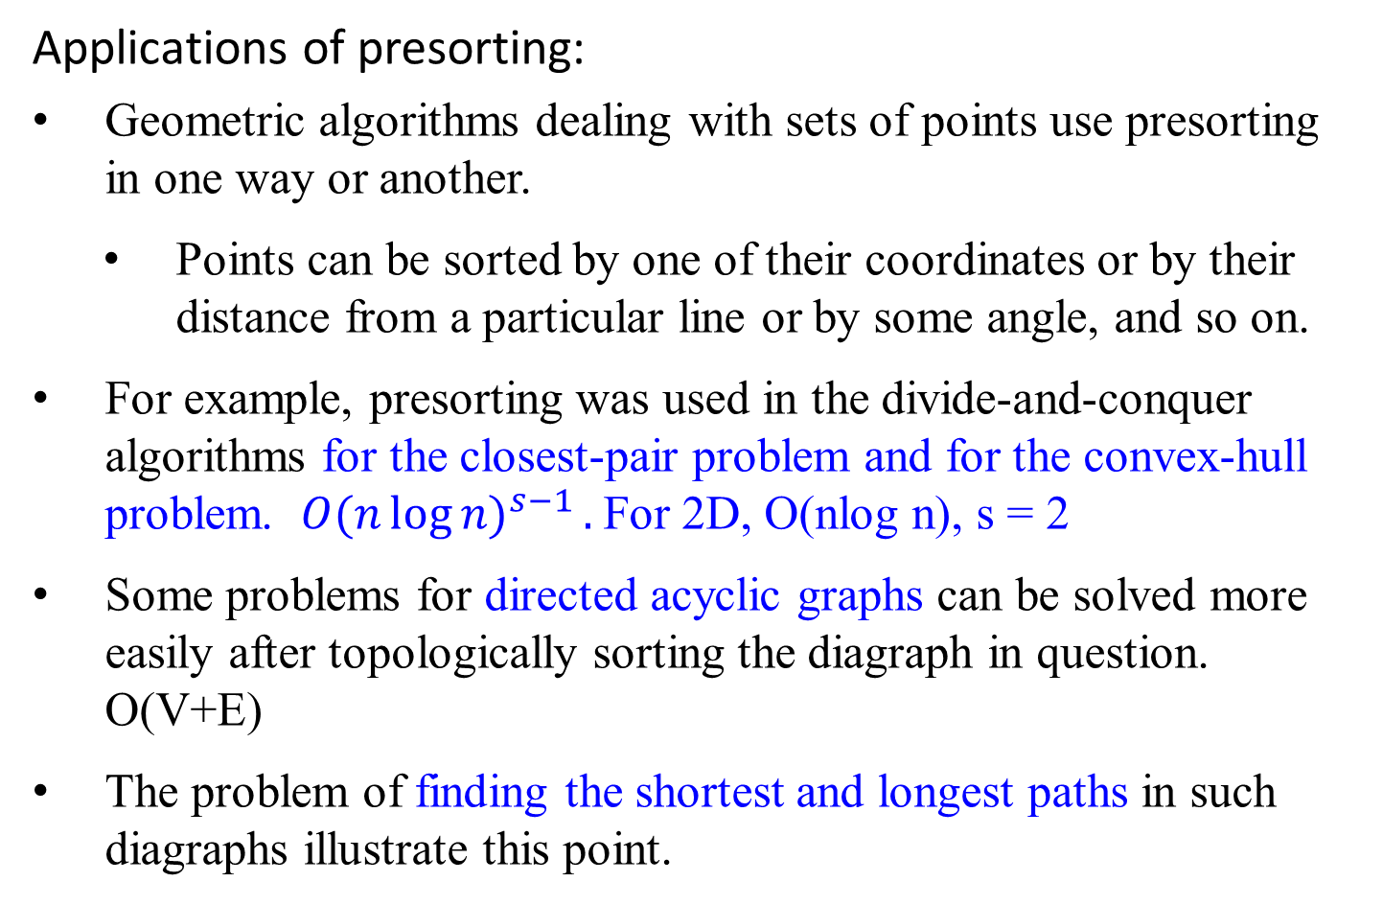
Transform-and-Conquer - Instance Simplification
Applications of presorting:
Geometric algorithms dealing with sets of points use presorting in one way or another.
Points can be sorted by one of their coordinates or by their distance from a particular line or by some angle, and so on.
For example, presorting was used in the divide-and-conquer algorithms for the closest-pair problem and for the convex-hull problem. ${O(n\log{n)}}^{s−1}.$For 2D, O(nlog n), s = 2
Some problems for directed acyclic graphs can be solved more easily after topologically sorting the diagraph in question. O(V+E)
The problem of finding the shortest and longest paths in such diagraphs illustrate this point.

Slide 27
Transform-and-Conquer – Representation change
Gaussian Elimination- representation change
Consider a system of two linear equations in two unknown:
a₁₁ x + a₁₂ y = b₁
a₂₁ x + a₂₂ y = b₂
The standard method for finding the solution for the system is:
use either equation to express one of the variables as a function of the other, such as x = (b₁/ a₁₁ ) - (a₁₂ / a₁₁ )y
substitute x in the other equation with x = (b₁/ a₁₁ ) - (a₁₂ / a₁₁ )y,
yielding a linear equation whose solution is then used for finding the value of the second variable.
a₂₁x + a₂₂y = b₂ yields a₂₁((b₁/a₁₁) - (a₁₂/a₁₁)y) + a₂₂y = b₂ .

Slide 28
Transform-and-Conquer – Representation change
Consider a system of n equations in a large number n unknowns:
a₁₁ x₁ + a₁₂ x₂ + … ₊ a_{1n} x_{n} = b₁
a₂₁ x₁ + a₂₂ x₂ + … ₊ a_{2n} x_{n} = b₂
…
a_{n1} x₁ + a_{n2} x₂ + … ₊ a_{nn} x_{n} = b_{n}
An elegant algorithm for solving system of linear equations called Gaussian elimination.

Slide 29
Transform-and-Conquer – Representation change
Gaussian elimination
The idea of Gaussian elimination is to
transform a system of n linear equations in n unknowns
to an equivalent system with
an upper triangular coefficient matrix,
a matrix with all zeros below its main diagonal:
(i.e., a system with the same solution as the original one)

Slide 30
Transform-and-Conquer – Representation change
a₁₁ x₁ + a₁₂ x₂ + … + a_{1n} x_{n} = b₁
a₂₁ x₁ + a₂₂ x₂ + … + a_{2n} x_{n} = b₂
a₃₁ x₁ + a₃₂ x₂ + … + a_{3n} x_{n} = b₃
…
a_{n1} x₁ + a_{n2} x₂ + … + a_{nn} x_{n} = b_{n}
a'₁₁ x₁ + a'₁₂ x₂ + … + a'_{1n} x_{n} = b'₁
a'₂₂ x₂ + … + a'_{2n} x_{n} = b'₂ where row 2 - (a₂₁/ a₁₁)* row 1;
row 3 - (a₃₁/ a₁₁)* row 1; ...
…
a'_{nn} x_{n} = b'_{n} row n - (a_{n1}/ a₁₁)* row 1; ...

Slide 31

Transform-and-Conquer – Representation change
In matrix notations, we can write it as
Ax = b A’x = b’,
where
a₁₁ a₁₂ … a_{1n} b₁
a₂₁ a₂₂ … a_{2n} b₂
A = … B = …
a_{n1} a_{n2} … a_{nn} b_{n}
$a_{11}^{′}$ ${ a}_{12}^{′}$ … $a_{1n}^{′}$ ${ b}_{1}^{′}$
0 $a_{22}^{′}$ … ${ a}_{2n}^{′}$ ${ b}_{2}^{′}$
A’ = … B’ = …
0 0 … ${ a}_{nn}^{′}$ ${ b}_{n}^{′}$

Slide 32

Transform-and-Conquer – Representation change
Example: Applying Gaussian elimination, solve the equation system $\frac{1}{2}$
2x₁ - x₂ + x₃ = 1
4x₁ + x₂ – x₃ = 5
x₁ + x₂ + x₃ = 0
row 2 – 4/2 row1 :row 2 - (a₂₁/ a₁₁)* row 1;
row 3 – 1/2 row1 :row 3 - (a₃₁/ a₁₁)* row 1;
row 3 – 1/2 row2
{where ½ = (3/2)/3}
2 |  | -1 |  | 1 |  | 1
4 |  | 1 |  | -1 |  | 5
1 |  | 1 |  | 1 |  | 0
2 |  | -1 |  | 1 |  | 1
0 |  | 3 |  | -3 |  | 3
0 |  | 3/2 |  | 1/2 |  | -1/2

Slide 33
Transform-and-Conquer – Representation change
2 |  | -1 |  | 1 |  | 1
0 |  | 3 |  | -3 |  | 3
0 |  | 3/2 |  | 1/2 |  | -1/2
row 3 – 1/2 row2, {where ½ = (3/2)/3}
2 |  | -1 |  | 1 |  | 1
0 |  | 3 |  | -3 |  | 3
0 |  | 0 |  | 2 |  | -2
Now we can obtain the solution by backward substitutions:
2x₁ - x₂ + x₃ = 1
3x₂ - 3x₃ = 3 yields
2x₃ = -2
x₃ = -2/2 = -1
x₂ = (3 +3 (-1))/3 = 0
x₁ = ( 1 – (-1)(0) – 1(-1))/2 = 1

Slide 34
Transform-and-Conquer – Representation change
Algorithm GaussElimination(A[1..n, 1..n], b[1..n])
//Applies Gaussian elimination to matrix A of a system’s coefficients,
//augmented with vector b of the system’s right-hand side values.
//Input: Matrix A[1 .. n, 1 .. n], and column-vector b[1 .. n]
//Output: An equivalent upper-triangular matrix in place of A with the
// corresponding right-hand side values in the (n+1)st column.
for (i ← 1 to n) do { //set b’s be arguments as the values
A[i, n+1] ← b[i]; /in the last column of the matrix
} //end for
for (i ← 1 to n-1) do {
for (j ← i+1 to n) do { //rows after setting ith row
for (k ← i to n+1) do {//column
A[j, k] ← A[j, k]- A[i, k]*A[j, i]/A[i, i];};};}

Slide 35
Transform-and-Conquer – Representation change
A[1, 1] A[1, 2] A[1, 3] A[1,4] A[1, 5] i
A[2, 1] A[2, 2] A[2, 3] A[2,4] A[2, 5] j
A[3, 1] A[3, 2] A[3, 3] A[3,4] A[3, 5]
A[4, 1] A[4, 2] A[4, 3] A[4,4] A[4, 5] 4x5
k
for (i ← 1 to n) do {
A[i, n+1] ← b[i];} //augments the matrix as the last col.
//end for
for (i ← 1 to n-1) do {
for (j ← i+1 to n) do{ //rows after setting ith row
for (k ← i to n+1) do { //column
A[j, k] ← A[j, k] - A[i, k]* A[j, i] / A[i, i];} ;} ;}

Slide 36
Transform-and-Conquer – Representation change
Example: Consider 4 x 5 matrix
A[1, 1] A[1, 2] A[1, 3] A[1,4] A[1, 5]
A[2, 1] A[2, 2] A[2, 3] A[2,4] A[2, 5]
A[3, 1] A[3, 2] A[3, 3] A[3,4] A[3, 5]
A[4, 1] A[4, 2] A[4, 3] A[4,4] A[4, 5]
4x5
i = 1 ≤ 3;
j = i+1 = 1+1=2 ≤ 4
A[j, k] ← A[j, k] - A[i, k]* A[j, i] / A[i, i], where i ≤ k ≤ 5
k = 1 ≤ 5 A[2,1] = A[2,1] – A[1,1] * A[2,1] / A[1,1]=0
k = 2 ≤ 5 A[2,2] = A[2,2] – A[1,2] * A[2,1] / A[1,1]
k = 3 ≤ 5 A[2,3] = A[2,3] – A[1,3] * A[2,1] / A[1,1]
k = 4 ≤ 5 A[2,4] = A[2,4] – A[1,4] * A[2,1] / A[1,1]
k = 5 ≤ 5 A[2,5] = A[2,5] – A[1,5] * A[2,1] / A[1,1]

Slide 37
Transform-and-Conquer – Representation change
Example: Consider 4 x 5 matrix
A[1, 1] A[1, 2] A[1, 3] A[1,4] A[1, 5]
A[2, 1]=0 A[2, 2] A[2, 3] A[2,4] A[2, 5]
A[3, 1] A[3, 2] A[3, 3] A[3,4] A[3, 5]
A[4, 1] A[4, 2] A[4, 3] A[4,4] A[4, 5]
4x5
j = 3 ≤ 4
A[j, k] ← A[j, k] - A[i, k]* A[j, i] / A[i, i]
k = 1 ≤ 5 A[3,1] = A[3,1] – A[1,1] * A[3,1] / A[1,1]=0
k = 2 ≤ 5 A[3,2] = A[3,2] – A[1,2] * A[3,1] / A[1,1]
k = 3 ≤ 5 A[3,3] = A[3,3] – A[1,3] * A[3,1] / A[1,1]
k = 4 ≤ 5 A[3,4] = A[3,4] – A[1,4] * A[3,1] / A[1,1]
k = 5 ≤ 5 A[3,5] = A[3,5] – A[1,5] * A[3,1] / A[1,1]

Slide 38
Transform-and-Conquer – Representation change
Example: Consider 4 x 5 matrix
A[1, 1] A[1, 2] A[1, 3] A[1,4] A[1, 5]
A[2, 1]=0 A[2, 2] A[2, 3] A[2,4] A[2, 5]
A[3, 1]=0 A[3, 2] A[3, 3] A[3,4] A[3, 5]
A[4, 1] A[4, 2] A[4, 3] A[4,4] A[4, 5]
4x5
j = 4 ≤ 4
A[j, k] ← A[j, k] - A[i, k]* A[j, i] / A[i, i]
k = 1 ≤ 5 A[4,1] = A[4,1] – A[1,1]*A[4,1]/A[1,1]=0
k = 2 ≤ 5 A[4,2] = A[4,2] – A[1,2]*A[4,1]/A[1,1]
k = 3 ≤ 5 A[4,3] = A[4,3] – A[1,3]*A[4,1]/A[1,1]
k = 4 ≤ 5 A[4,4] = A[4,4] – A[1,4]*A[4,1]/A[1,1]
k = 5 ≤ 5 A[4,5] = A[4,5] – A[1,5]*A[4,1]/A[1,1]

Slide 39
Transform-and-Conquer – Representation change
Example: Consider 4 x 5 matrix
A[1, 1] A[1, 2] A[1, 3] A[1,4] A[1, 5]
A[2, 1]=0 A[2, 2] A[2, 3] A[2,4] A[2, 5]
A[3, 1]=0 A[3, 2] A[3, 3] A[3,4] A[3, 5]
A[4, 1]=0 A[4, 2] A[4, 3] A[4,4] A[4, 5]
4x5
i = 2 ≤ 3;
j = i+1 = 2+1=3 ≤ 4
A[j, k] ← A[j, k] - A[i, k]* A[j, i] / A[i, i], where i ≤ k ≤ 5
k = 2 ≤ 5 A[3,2] = A[3,2] – A[2,2]*A[3,2]/A[2,2]=0
k = 3 ≤ 5 A[3,3] = A[3,3] – A[2,3]*A[3,2]/A[2,2]
k = 4 ≤ 5 A[3,4] = A[3,4] – A[2,4]*A[3,2]/A[2,2]
k = 5 ≤ 5 A[3,5] = A[3,5] – A[2,5]*A[3,2]/A[2,2]

Slide 40
Transform-and-Conquer – Representation change
Example: Consider 4 x 5 matrix
A[1, 1] A[1, 2] A[1, 3] A[1,4] A[1, 5]
A[2, 1]=0 A[2, 2] A[2, 3] A[2,4] A[2, 5]
A[3, 1]=0 A[3, 2]=0 A[3, 3] A[3,4] A[3, 5]
A[4, 1]=0 A[4, 2] A[4, 3] A[4,4] A[4, 5]
4x5
i = 2 ≤ 3;
j = i+1 = 2+1=4 ≤ 4
A[j, k] ← A[j, k] - A[i, k]* A[j, i] / A[i, i], where i ≤ k ≤ 5
k = 2 ≤ 5 A[4,2] = A[4,2] – A[2,2]*A[4,2]/A[2,2]=0
k = 3 ≤ 5 A[4,3] = A[4,3] – A[2,3]*A[4,2]/A[2,2]
k = 4 ≤ 5 A[4,4] = A[4,4] – A[2,4]*A[4,2]/A[2,2]
k = 5 ≤ 5 A[4,5] = A[4,5] – A[2,5]*A[4,2]/A[2,2]

Slide 41
Transform-and-Conquer – Representation change
Example: Consider 4 x 5 matrix
A[1, 1] A[1, 2] A[1, 3] A[1,4] A[1, 5]
A[2, 1]=0 A[2, 2] A[2, 3] A[2,4] A[2, 5]
A[3, 1]=0 A[3, 2]=0 A[3, 3] A[3,4] A[3, 5]
A[4, 1]=0 A[4, 2]=0 A[4, 3] A[4,4] A[4, 5]
4x5
i = 3 ≤ 3;
j = i+1 = 3+1=4 ≤ 4
A[j, k] ← A[j, k] - A[i, k]* A[j, i] / A[i, i], where i ≤ k ≤ 5
k = 3 ≤ 5 A[4,3] = A[4,3] – A[3,3]*A[4,3]/A[3,3]=0
k = 4 ≤ 5 A[4,4] = A[4,4] – A[3,4]*A[4,3]/A[3,3]
k = 5 ≤ 5 A[4,5] = A[4,5] – A[3,5]*A[4,3]/A[3,3]

Slide 42
Transform-and-Conquer – Representation change
Example: Consider 4 x 5 matrix
A[1, 1] A[1, 2] A[1, 3] A[1,4] A[1, 5]
A[2, 1]=0 A[2, 2] A[2, 3] A[2,4] A[2, 5]
A[3, 1]=0 A[3, 2]=0 A[3, 3] A[3,4] A[3, 5]
A[4, 1]=0 A[4, 2]=0 A[4, 3]=0 A[4,4] A[4, 5]
4x5
That is,
A[1, 1] A[1, 2] A[1, 3] A[1,4] A[1, 5]
0 A[2, 2] A[2, 3] A[2,4] A[2, 5]
0 0 A[3, 3] A[3,4] A[3, 5]
0 0 0 A[4,4] A[4, 5]
4x5

Slide 43
Transform-and-Conquer – Representation change
There are two important observations to make about this pseudocode.
First, it is not always correct:
if A[i, i] = 0, A[i. i] cannot be a divisor, and
the i^{th} row cannot be used as a pivot for the i^{th} iteration of the algorithm.
Then, exchange the i^{th} row with some row below it that has a nonzero coefficient in the i^{th} column.
Such a row must exist, if the system has a unique solution.

Slide 44
There are two important observations to make about this pseudocode.
First, it is not always correct:
…
To prepare for the possibility of row exchanges, another potential difficulty has to be taken care:
It is possible that A[i, i] is very small and A[j, i] / A[i, i] so large that the new value of A[j, k] might become distorted by a round-off error caused by a subtraction of two numbers of greatly different magnitudes.
To avoid this problem, always look for a row with the largest absolute value of the coefficient in the i^{th} column, exchange it with the i^{th} row, and then use the new A[i, i] as the i^{th} iteration’s pivot.
This modification called partial pivoting, guarantees that the magnitude of the scaling factor will never exceed 1.

Slide 45
Transform-and-Conquer – Representation change
There are two important observations to make about this pseudocode.
First, it is not always correct:
if A[i, i] = 0, we cannot divide by it and
Then, exchange the i^{th} row with some row below it that has a nonzero coefficient in the i^{th} column.
Such a row must exist, if the system has a unique solution.
The second observation is the fact that the innermost loop is written with a glaring inefficiency.
Can you find it before checking the following pseudocode, which both incorporates partial pivoting and eliminates this inefficiency?

Slide 46
Algorithm BetterGaussElimination(A[1..n, 1..n], b[1..n])
//Implements Gaussian elimination with partial pivoting
//Input: Matrix A[1..n, 1..n], and column-vector b[1..n]
//Output: An equivalent upper-triangular matrix in place of a with the
// corresponding right-hand side values in the (n+1)st column.
for (i ← 1 to n) do {
A[i, n+1] ← b[i]; } //appends b to A as the last col.
//end for-do
for (i ← 1 to n-1) do {
pivotrow ← i;
for (j ← i+1 to n) do {
if ( |A[j, i]| > |A[pivotrow, i]| ) {
pivotrow ← j; } //end if; end for-do
for (k ← i to n+1) do {
swap(A[i, k], A[pivotrow, k]); } //end for-do
for (j ← i+1 to n) do {
temp ← A[j, i] / A[i, i];
for (k ← i to n+1) do {
A[j, k] ← A[j, k] - A[i, k] * temp;} //end for-do
} //end for-do
} //end for-do

Slide 47
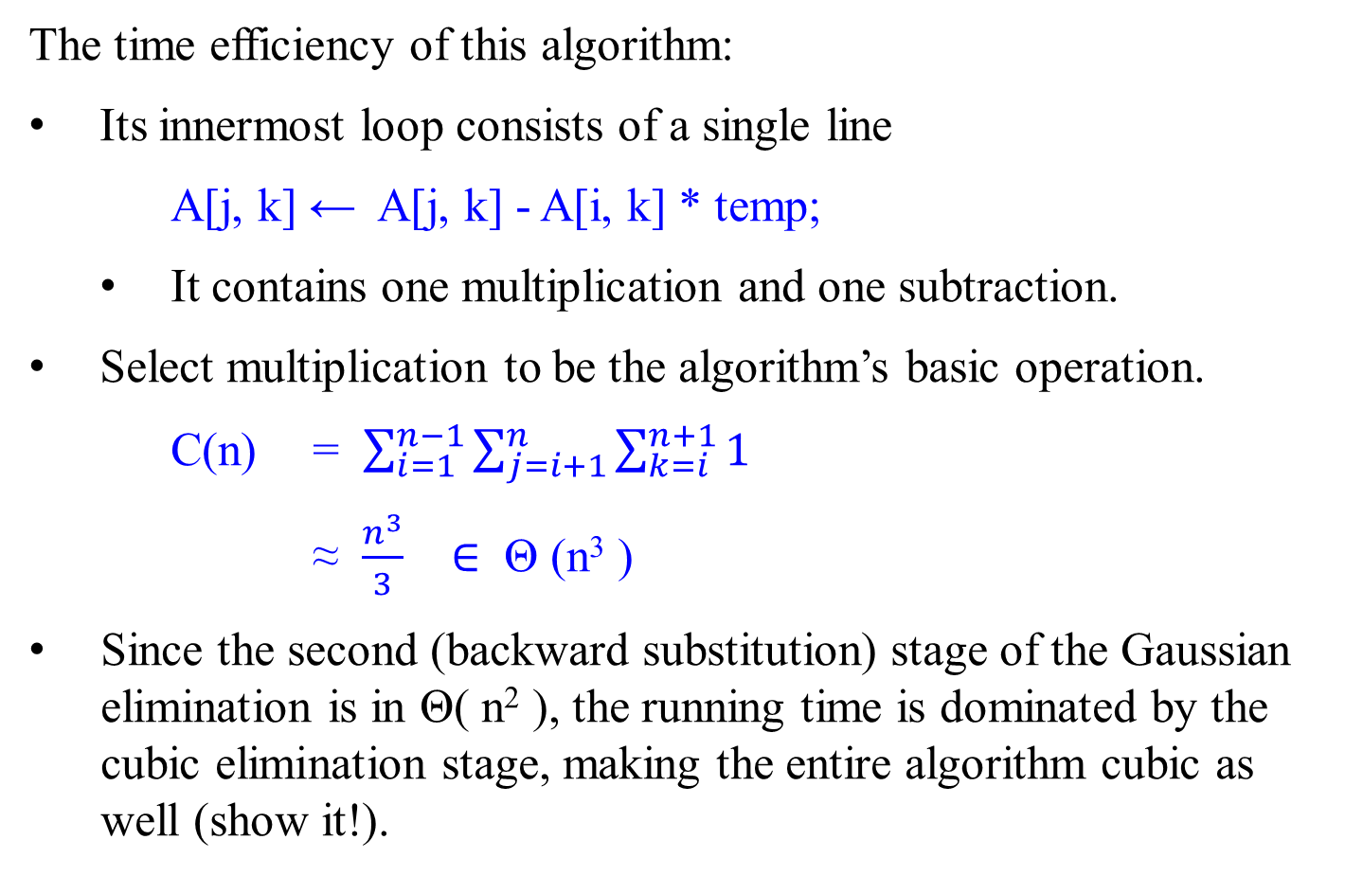
Transform-and-Conquer – Representation change
The time efficiency of this algorithm:
Its innermost loop consists of a single line
A[j, k] ← A[j, k] - A[i, k] * temp;
It contains one multiplication and one subtraction.
Select multiplication to be the algorithm’s basic operation.
C(n) = $\sum_{i=1}^{n−1}{\sum_{j=i+1}^{n}{\sum_{k=i}^{n+1}{1}}}$
≈ $\frac{n^{3}}{3}$ $∈$ Θ (n³ )
Since the second (backward substitution) stage of the Gaussian elimination is in Θ( n² ), the running time is dominated by the cubic elimination stage, making the entire algorithm cubic as well (show it!).

Slide 48
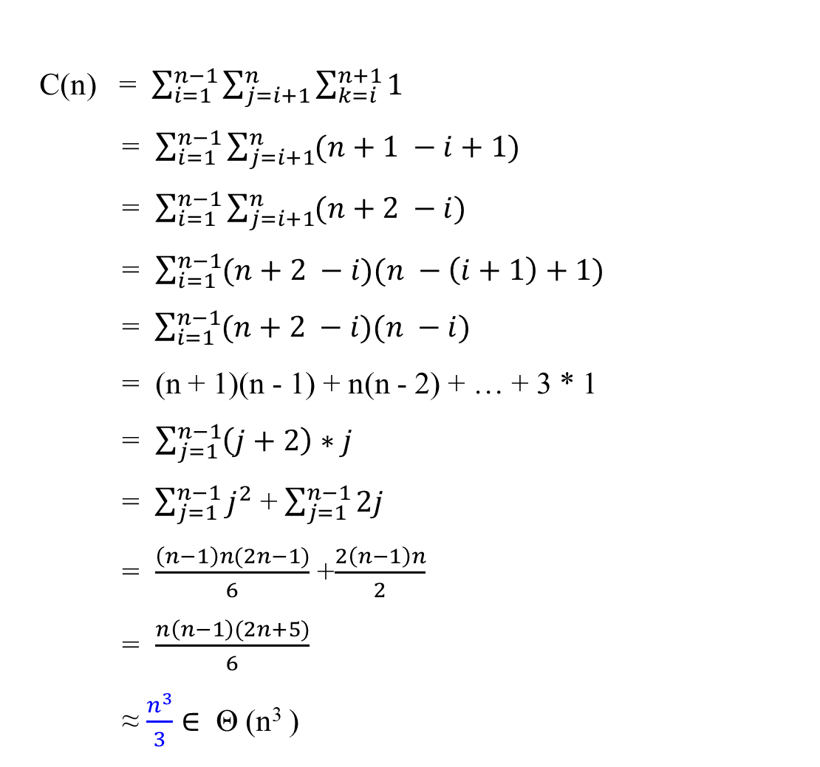
Transform-and-Conquer – Representation change
C(n) = $\sum_{i=1}^{n−1}{\sum_{j=i+1}^{n}{\sum_{k=i}^{n+1}{1}}}$
= $\sum_{i=1}^{n−1}{\sum_{j=i+1}^{n}{(n+1 −i+1)}}$
= $\sum_{i=1}^{n−1}{\sum_{j=i+1}^{n}{(n+2 −i)}}$
= $\sum_{i=1}^{n−1}{(n+2 −i)(n −\left(i+1\right)+1)}$
= $\sum_{i=1}^{n−1}{(n+2 −i)(n −i)}$
= (n + 1)(n - 1) + n(n - 2) + … + 3 * 1
= $\sum_{j=1}^{n−1}{\left(j+2\right)∗j}$
= $\sum_{j=1}^{n−1}{j^{2}}$ + $\sum_{j=1}^{n−1}{2j}$
= $\frac{\left(n−1\right)n(2n−1)}{6}$ +$\frac{2\left(n−1\right)n}{2}$
= $\frac{n\left(n−1\right)(2n+5)}{6}$
≈ $\frac{n^{3}}{3}$ $∈$ Θ (n³ )

Slide 49
Transform-and-Conquer – Representation change
Another way for solving systems of linear equations,
using LU Decomposition,
a by-product of Gaussian elimination.

Slide 50
Transform-and-Conquer – Representation change
LU Decomposition and Other Applications
Gaussian elimination has an useful by-product called LU decomposition of the coefficient matrix.
Example: Solve the following system of linear equations, using LU decomposition produced by the Gaussian elimination.
2x₁ - x₂ + x₃ = 1
4x₁ + x₂ – x₃ = 5
x₁ + x₂ + x₃ = 0
A =
2 |  | -1 |  | 1
4 |  | 1 |  | -1
1 |  | 1 |  | 1

Slide 51
Transform-and-Conquer – Representation change
LU Decomposition and Other Applications
Solve the given system of equations using LU decomposition by Gaussian elimination
2x₁ - x₂ + x₃ = 1
From 4x₁ + x₂ - x₃ = 5 obtain A =
x₁ + x₂ + x₃ = 0
First, apply the Gaussian elimination process on A to obtain the upper-triangular matrix U which is as follows. (The detailed of work is given in next slide.)
U =
2 |  | -1 |  | 1
4 |  | 1 |  | -1
1 |  | 1 |  | 1
2 | -1 | 1
0 | 3 | -3
0 | 0 | 2

Slide 52
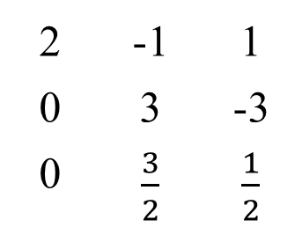
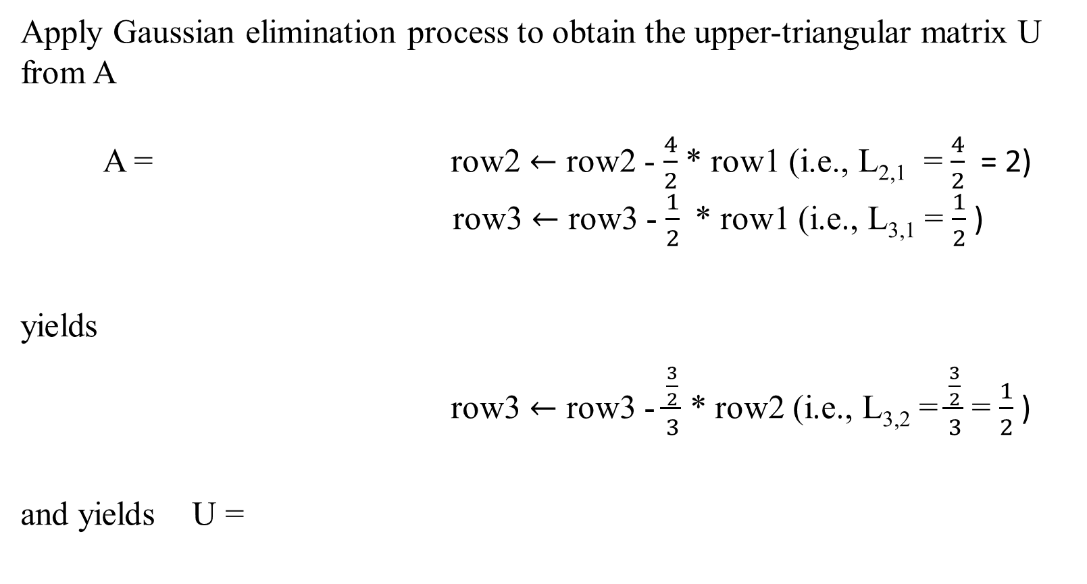
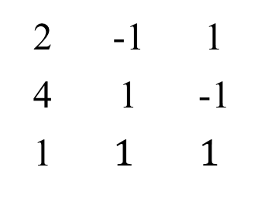
Transform-and-Conquer – Representation change
Apply Gaussian elimination process to obtain the upper-triangular matrix U from A
A = row2 $←$ row2 - $\frac{4}{2}$ * row1 (i.e., L_{2,1} = $\frac{4}{2}$ = 2)
row3 $←$ row3 - $\frac{1}{2}$ * row1 (i.e., L_{3,1} = $\frac{1}{2}$ )
yields
row3 $←$ row3 - $\frac{\frac{3}{2}}{3}$ * row2 (i.e., L_{3,2} = $\frac{\frac{3}{2}}{3}$ = $\frac{1}{2}$ )
and yields U =
2 | -1 | 1
4 | 1 | -1
1 | $$1$$ | $$1$$
2 | -1 | 1
0 | 3 | -3
0 | $\frac{3}{2}$ | $\frac{1}{2}$
2 | -1 | 1
0 | 3 | -3
0 | 0 | 2

Slide 53
Transform-and-Conquer – Representation change
LU Decomposition and Other Applications
Secondly, the lower-triangular matrix L is made up of 1’s on its main diagonal and the row multiples used in the Gaussian elimination process.
L = =
1 | 0 | 0
L₂₁ | 1 | 0
L₃₁ | L₃₂ | 1
1 | 0 | 0
2 | 1 | 0
1/2 | 1/2 | 1

Slide 54
LU Decomposition and Other Applications
Applying the Gaussian elimination process on A, we obtained the upper-triangular matrix U and the lower triangular matrix L.
A =
U =
L =
2 | -1 | 1
4 | 1 | -1
1 | 1 | 1
2 | -1 | 1
0 | 3 | -3
0 | 0 | 2
1 | 0 | 0
2 | 1 | 0
1/2 | 1/2 | 1

Slide 55
Transform-and-Conquer – Representation change
It turns out that A = L * U.
A =
= L * U
= *
2 |  | -1 |  | 1
4 |  | 1 |  | -1
1 |  | 1 |  | 1
1 | 0 | 0
2 | 1 | 0
1/2 | 1/2 | 1
2 | -1 | 1
0 | 3 | -3
0 | 0 | 2

Slide 56
Transform-and-Conquer – Representation change
Example: Solve the following system of linear equations, using LU decomposition produced by the Gaussian elimination.
2x₁ - x₂ + x₃ = 1
4x₁ + x₂ – x₃ = 5
x₁ + x₂ + x₃ = 0
So far L and U are obtained for the given equation system.
By observation, solving the system Ax = b is equivalent to solving the system LUx = b.
The system LUx = b can be solved as follows.
Let y = Ux, then Ly = b.
Solve the system Ly = b first, with the lower-triangular matrix L to find y;
then solve the system Ux = y, with the upper-triangular matrix U, to find x.

Slide 57
Transform-and-Conquer – Representation change
Thus, for solving the following system of linear equations:
2x₁ - x₂ + x₃ = 1
4x₁ + x₂ – x₃ = 5 leading to
x₁ + x₂ + x₃ = 0
we first solve Ly = b:
It solution is
y₁ = 1,
y₂ = 5 - 2 y₁ = 3,
y₃ = 0 – y₁/2 – y₂ /2 = -2.
2 |  | -1 |  | 1
4 |  | 1 |  | -1
1 |  | 1 |  | 1
1 | 0 | 0
2 | 1 | 0
1/2 | 1/2 | 1
y₁ |  | 1
y₂ | = | 5
y₃ |  | 0

Slide 58
Transform-and-Conquer – Representation change
Solving Ux = y means solving
and the solution is
x₃ = (-2)/2 = -1,
x₂ = (3 – (-3) x₃ ) / 3 = 0 ,
x₁ = (1 - x₃ - ( -1) x₂ )/2 = 1
2 | -1 | 1
0 | 3 | -3
0 | 0 | 2
x₁ |  | 1
x₂ | = | 3
x₃ |  | -2

Slide 59
Transform-and-Conquer – Representation change
Require extra memory for the LU decomposition:
store the nonzero part of U in the upper-triangular part of A (including the main diagonal) and
store the nontrivial part of L below the main diagonal of A.

Slide 60
Compute the Matrix Inverse A⁻¹
of an n-by-n Matrix A,
by applying Gaussian elimination

Slide 61
Transform-and-Conquer – Representation change
Computing a Matrix Inverse
The n-by-n identity matrix is the matrix with all zero elements except that the main diagonal element are all ones.
Apply Gaussian elimination to compute a matrix inverse.
The inverse of an n-by-n matrix A is
an n-by-n matrix, denoted A⁻¹ , such that
A A⁻¹ = I,
where I is the n-by-n identity matrix.
If a matrix A does not have an inverse, it is called singular.
Otherwise, the matrix is nonsingular.

Slide 62
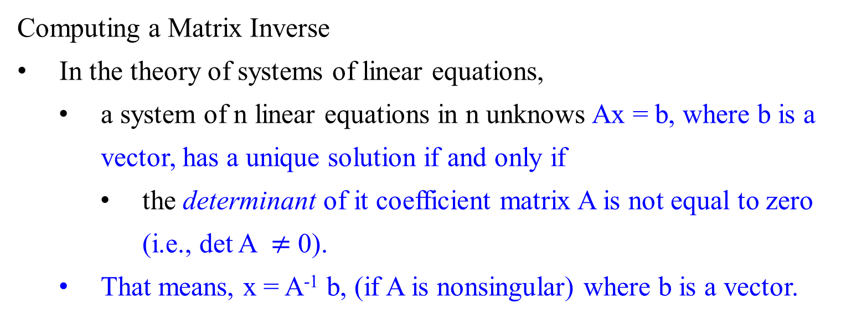
Transform-and-Conquer – Representation change
Computing a Matrix Inverse
In the theory of systems of linear equations,
a system of n linear equations in n unknows Ax = b, where b is a vector, has a unique solution if and only if
the determinant of it coefficient matrix A is not equal to zero (i.e., det A $≠$ 0).
That means, x = A⁻¹ b, (if A is nonsingular) where b is a vector.

Slide 63
Transform-and-Conquer – Representation change
Computing a Matrix Inverse
Apply Gaussian elimination to check whether a matrix is nonsingular
the matrix is nonsingular: if it yields an upper-triangular matrix with non zeros on the main diagonal;
it is singular: otherwise.
Most square matrix do have their inverses.

Slide 64

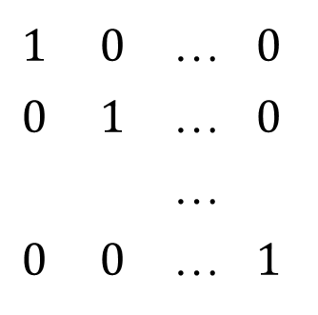
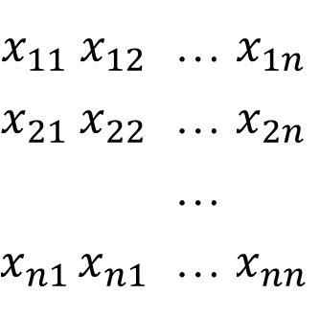
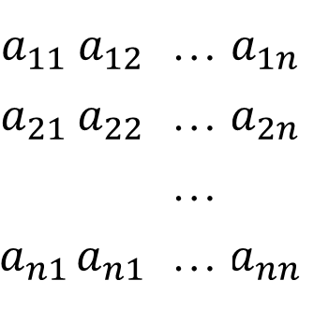
Transform-and-Conquer – Representation change
Computing a Matrix Inverse
A solution to a system of n linear equations in n unknows Ax = b as x = A⁻¹ b, if A is nonsingular.
For computing the inverse matrix A⁻¹ for a nonsingular n-by-n-matrix A, we need to find x_{ij} , 1 $≤$ i, j $≤$ n, such that
=
$$a_{11}$$ | $$a_{12}$$ | … | $$a_{1n}$$
$$a_{21}$$ | $$a_{22}$$ | … | $$a_{2n}$$
 |  | …
$$a_{n1}$$ | $$a_{n1}$$ | … | $$a_{nn}$$
$$x_{11}$$ | $$x_{12}$$ | … | $$x_{1n}$$
$$x_{21}$$ | $$x_{22}$$ | … | $$x_{2n}$$
 |  | …
$$x_{n1}$$ | $$x_{n1}$$ | … | $$x_{nn}$$
$$1$$ | $$0$$ | … | $$0$$
$$0$$ | $$1$$ | … | $$0$$
 |  | …
$$0$$ | $$0$$ | … | $$1$$

Slide 65

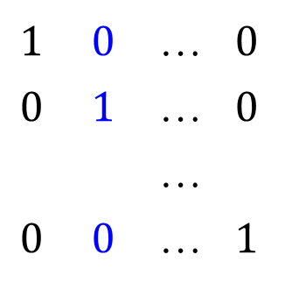
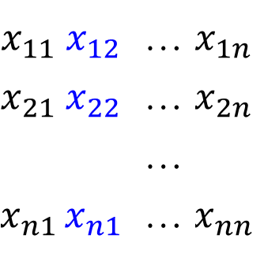
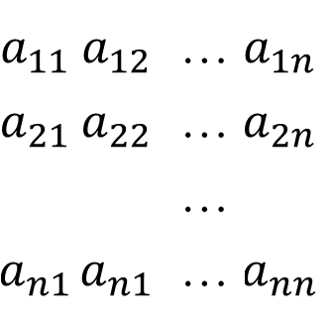
Transform-and-Conquer – Representation change
Computing a Matrix Inverse
For computing the inverse matrix A⁻¹ we need to find x_{ij}, 1 $≤$ i, j $≤$ n, such that
=
Find the unknowns x_{ij}, 1 $≤$ i, j $≤$ n, by solving n systems of linear equations A x^{j} = e^{j} , that have
the same coefficient matrix A,
the vector of unknowns x^{j} is the j^{th} column of the inverse, and the right-hand side vector e^{j} is the j^{th} column of the identity matrix (1 $≤$ i, j $≤$ n ).
$$a_{11}$$ | $$a_{12}$$ | … | $$a_{1n}$$
$$a_{21}$$ | $$a_{22}$$ | … | $$a_{2n}$$
 |  | …
$$a_{n1}$$ | $$a_{n1}$$ | … | $$a_{nn}$$
$$x_{11}$$ | $$x_{12}$$ | … | $$x_{1n}$$
$$x_{21}$$ | $$x_{22}$$ | … | $$x_{2n}$$
 |  | …
$$x_{n1}$$ | $$x_{n1}$$ | … | $$x_{nn}$$
$$1$$ | $$0$$ | … | $$0$$
$$0$$ | $$1$$ | … | $$0$$
 |  | …
$$0$$ | $$0$$ | … | $$1$$

Slide 66

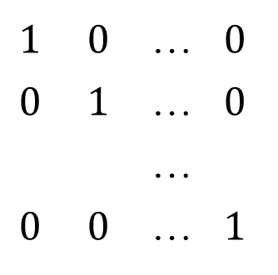
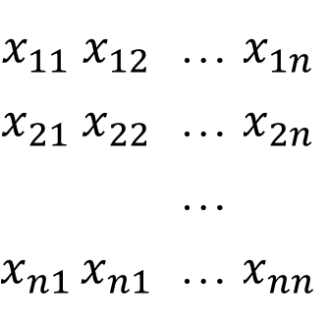

Transform-and-Conquer – Representation change
Computing a Matrix Inverse
For computing the inverse matrix A⁻¹ for a nonsingular n-by-n-matrix A, we need to find x_{ij} , 1 $≤$ i, j $≤$ n, such that
=
We can solve these systems by applying Gaussian elimination to matrix A augmented by the n-by-n identity matrix.
We can use Gaussian elimination to find the LU decomposition of A and then solve the system LU x^{j} = e^{j}, (1 $≤$ j $≤$ n ).
$$a_{11}$$ | $$a_{12}$$ | … | $$a_{1n}$$
$$a_{21}$$ | $$a_{22}$$ | … | $$a_{2n}$$
 |  | …
$$a_{n1}$$ | $$a_{n1}$$ | … | $$a_{nn}$$
$$x_{11}$$ | $$x_{12}$$ | … | $$x_{1n}$$
$$x_{21}$$ | $$x_{22}$$ | … | $$x_{2n}$$
 |  | …
$$x_{n1}$$ | $$x_{n1}$$ | … | $$x_{nn}$$
$$1$$ | $$0$$ | … | $$0$$
$$0$$ | $$1$$ | … | $$0$$
 |  | …
$$0$$ | $$0$$ | … | $$1$$

Slide 67
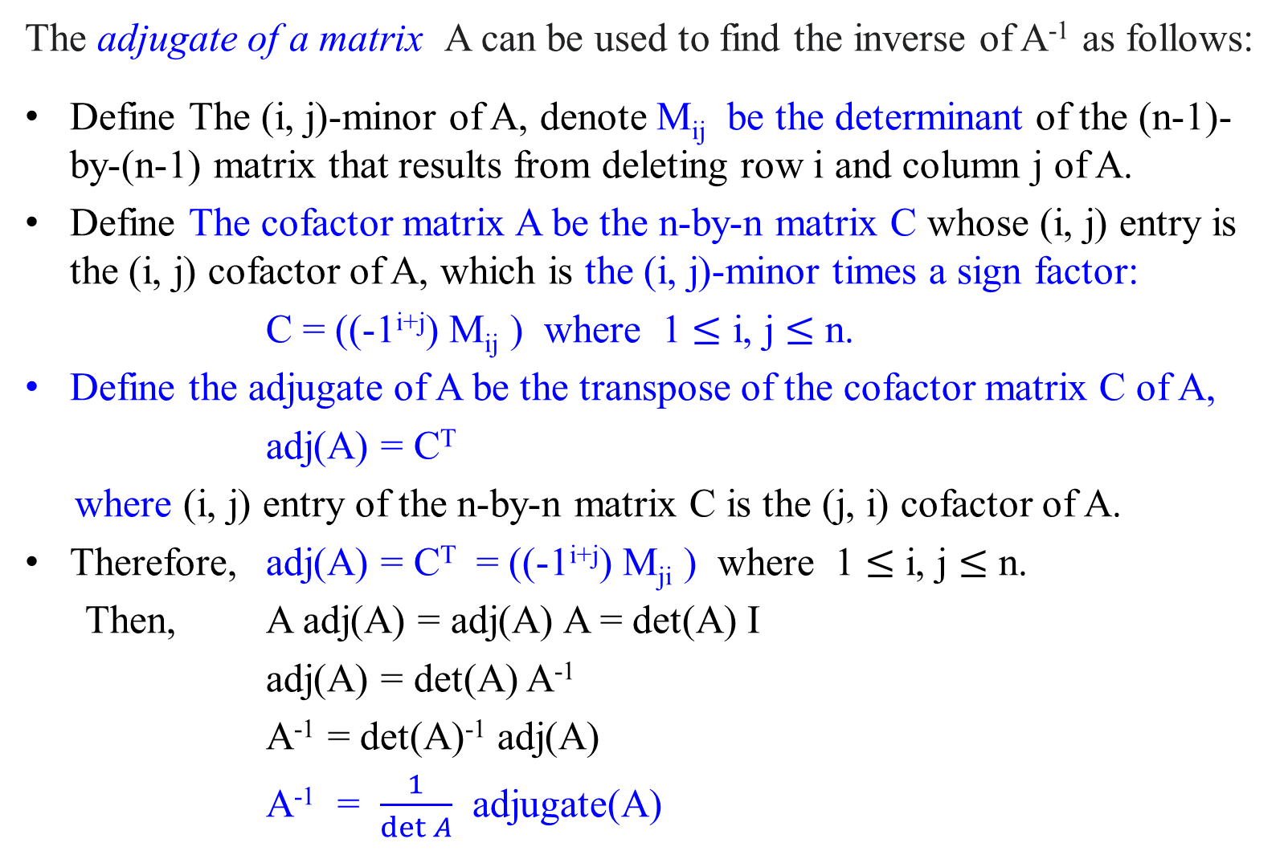
The adjugate of a matrix A can be used to find the inverse of A⁻¹ as follows:
Define The (i, j)-minor of A, denote M_{ij} be the determinant of the (n-1)-by-(n-1) matrix that results from deleting row i and column j of A.
Define The cofactor matrix A be the n-by-n matrix C whose (i, j) entry is the (i, j) cofactor of A, which is the (i, j)-minor times a sign factor:
C = ((-1^{i+j}) M_{ij} ) where 1 $≤$ i, j $≤$ n.
Define the adjugate of A be the transpose of the cofactor matrix C of A,
adj(A) = C^{T}
where (i, j) entry of the n-by-n matrix C is the (j, i) cofactor of A.
Therefore, adj(A) = C^{T} = ((-1^{i+j}) M_{ji} ) where 1 $≤$ i, j $≤$ n.
Then, A adj(A) = adj(A) A = det(A) I
adj(A) = det(A) A⁻¹
A⁻¹ = det(A)⁻¹ adj(A)
A⁻¹ = $\frac{1}{\det{A}}$ adjugate(A)

Slide 68
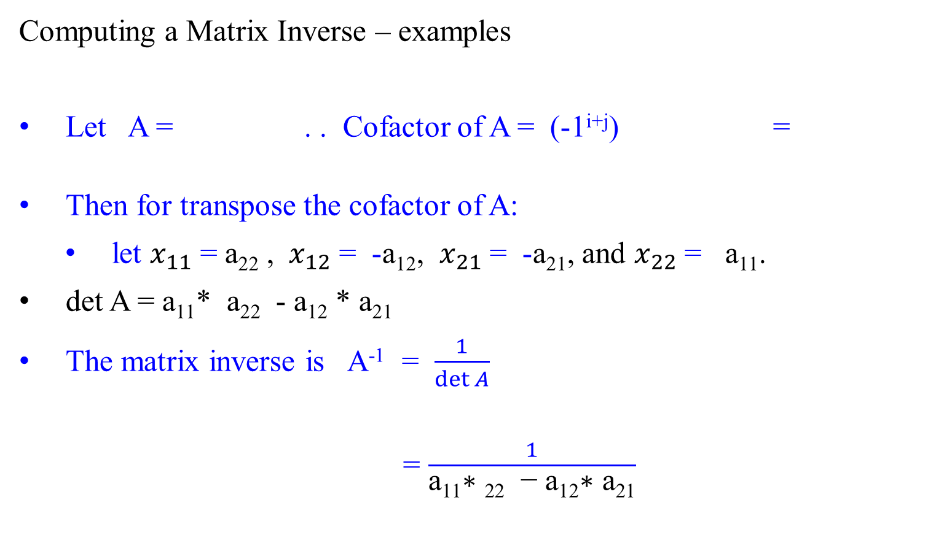
Transform-and-Conquer – Representation change
Computing a Matrix Inverse – examples
Let A = . . Cofactor of A = (-1^{i+j}) =
Then for transpose the cofactor of A:
let $x_{11}$ = a₂₂ , ${ x}_{12}$ = -a₁₂, $x_{21}$ = -a₂₁, and $x_{22}$ = a₁₁.
det A = a₁₁* a₂₂ - a₁₂ * a₂₁
The matrix inverse is A⁻¹ = $\frac{1}{\det{A}}$
= $\frac{1}{\text{a}\text{11}\text{∗ }\text{22}\text{ − }\text{a}\text{12}\text{∗ }\text{a}\text{21}}$
a₁₁ | a₁₂
a₂₁ | a₂₂
a₂₂ | a₂₁
a₁₂ | a₁₁
a₂₂ | -a₂₁
-a₁₂ | a₁₁
x₁₁ | x₁₂
x₂₁ | x₂₂
a₂₂ | -a₁₂
-a₂₁ | a₁₁

Slide 69

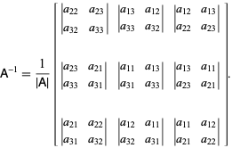

Transpose cofactor of A can be computed:
T
Then,
A⁻¹ = $\frac{1}{\det{A} }$(Transpose cofactor of A)
For a 3 x 3 matrix
The matrix inverse is:
+d |  | -d |  | +d |  | -d | …
-d |  | +d |  | -d |  | +d | …
+d |  | -d |  | +d |  | -d | …
-d |  | +d |  | -d |  | +d | …
 |  |  |  | …

Slide 70

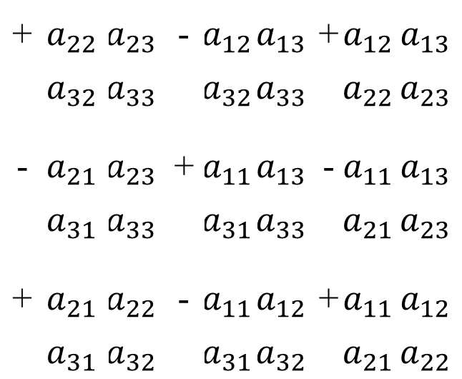
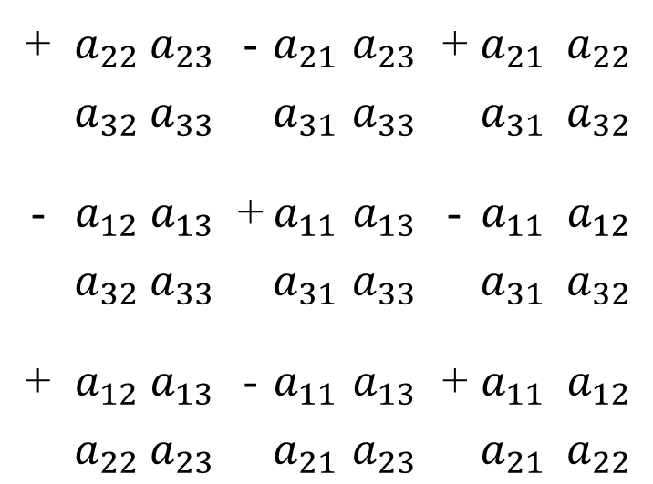
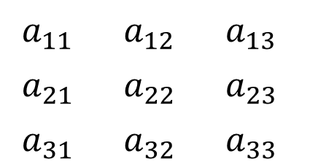
Transform-and-Conquer – Representation change
$$1$$ | $$0$$ | … | $$0$$
$$0$$ | $$1$$ | … | $$0$$
 |  | …
$$0$$ | $$0$$ | … | $$1$$
Computing a Matrix Inverse - examples
For a 3x3 matrix A =
The matrix inverse A⁻¹ can be obtained: Transpose cofactor matrix of A
T
$$a_{11}$$ | $$a_{12}$$ | $$a_{13}$$
$$a_{21}$$ | $$a_{22}$$ | $$a_{23}$$
$$a_{31}$$ | $$a_{32}$$ | $$a_{33}$$
+ | $$a_{22}$$ | $$a_{23}$$ | - | $$a_{21}$$ | $$a_{23}$$ | + | $$a_{21}$$ | $$a_{22}$$
 | $$a_{32}$$ | $$a_{33}$$ |  | $$a_{31}$$ | $$a_{33}$$ |  | $$a_{31}$$ | $$a_{32}$$
- | $$a_{12}$$ | $$a_{13}$$ | + | $$a_{11}$$ | $$a_{13}$$ | - | $$a_{11}$$ | $$a_{12}$$
 | $$a_{32}$$ | $$a_{33}$$ |  | $$a_{31}$$ | $$a_{33}$$ |  | $$a_{31}$$ | $$a_{32}$$
+ | $$a_{12}$$ | $$a_{13}$$ | - | $$a_{11}$$ | $$a_{13}$$ | + | $$a_{11}$$ | $$a_{12}$$
 | $$a_{22}$$ | $$a_{23}$$ |  | $$a_{21}$$ | $$a_{23}$$ |  | $$a_{21}$$ | $$a_{22}$$
+ | $$a_{22}$$ | $$a_{23}$$ | - | $$a_{12}$$ | $$a_{13}$$ | + | $$a_{12}$$ | $$a_{13}$$
 | $$a_{32}$$ | $$a_{33}$$ |  | $$a_{32}$$ | $$a_{33}$$ |  | $$a_{22}$$ | $$a_{23}$$
- | $$a_{21}$$ | $$a_{23}$$ | + | $$a_{11}$$ | $$a_{13}$$ | - | $$a_{11}$$ | $$a_{13}$$
 | $$a_{31}$$ | $$a_{33}$$ |  | $$a_{31}$$ | $$a_{33}$$ |  | $$a_{21}$$ | $$a_{23}$$
+ | $$a_{21}$$ | $$a_{22}$$ | - | $$a_{11}$$ | $$a_{12}$$ | + | $$a_{11}$$ | $$a_{12}$$
 | $$a_{31}$$ | $$a_{32}$$ |  | $$a_{31}$$ | $$a_{32}$$ |  | $$a_{21}$$ | $$a_{22}$$

Slide 71
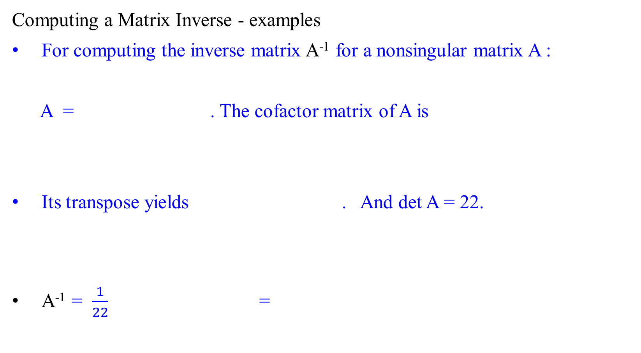
Transform-and-Conquer – Representation change
Computing a Matrix Inverse - examples
For computing the inverse matrix A⁻¹ for a nonsingular matrix A :
A = . The cofactor matrix of A is
Its transpose yields . And det A = 22.
A⁻¹ = $\frac{1}{22}$ =
1 | 2 | 3
0 | 4 | 5
1 | 0 | 6
24 | 5 | -4
-12 | 3 | 2
-2 | -5 | 4
24 | -12 | -2
5 | 3 | -5
-4 | 2 | 4
24 | -12 | -2
5 | 3 | -5
-4 | 2 | 4
12/11 | -6/11 | -1/11
5/22 | 3/22 | -5/22
-2/11 | 1/11 | 2/11

Slide 72
Compute Determinants
And
Cramer’s rule

Slide 73
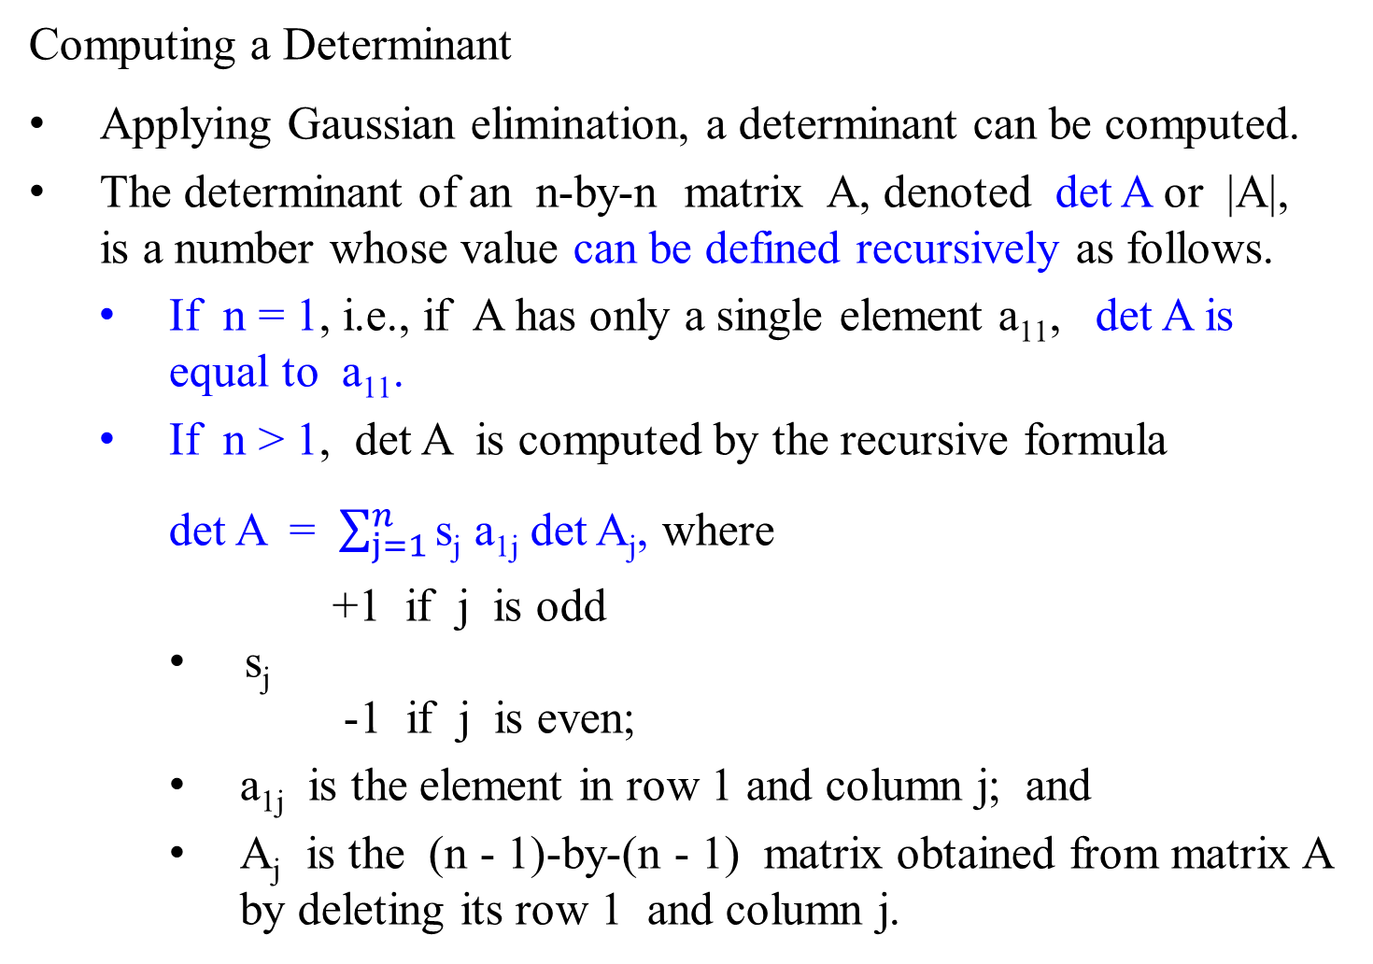
Computing a Determinant
Applying Gaussian elimination, a determinant can be computed.
The determinant of an n-by-n matrix A, denoted det A or |A|, is a number whose value can be defined recursively as follows.
If n = 1, i.e., if A has only a single element a₁₁, det A is equal to a₁₁.
If n > 1, det A is computed by the recursive formula
det A = $\sum_{j=1}^{n}{\text{s}\text{j} \text{a}\text{1}\text{j}}$ det A_{j}, where
+1 if j is odd
s_{j}
-1 if j is even;
a_{1j} is the element in row 1 and column j; and
A_{j} is the (n - 1)-by-(n - 1) matrix obtained from matrix A by deleting its row 1 and column j.

Slide 74

Computing a Determinant
If A = [a₁₁], then det A = a₁₁ .
For 2-by-2 matrix,
det = a₁₁det[a₂₂] - a₁₂det [a₂₁]
= a₁₁ a₂₂ - a₁₂ a₂₁.
For 3-by-3 matrix,
det = $a_{11}$det - $a_{12}$det
+ $a_{13}$det
= $a_{11}a_{22}a_{33}$+ $a_{12}a_{23}a_{31}$+ $a_{21}a_{32}a_{13}$ - $a_{31}a_{22}a_{13}$- $a_{21}a_{12}a_{33}$- $a_{32}a_{23}a_{11}$
a₁₁ | a₁₂
a₂₁ | a₂₂
a₁₁ | a₁₂ | a₁₃
a₂₁ | a₂₂ | a₂₃
a₃₁ | a₃₂ | a₃₃
a₂₂ | a₂₃
a₃₂ | a₃₃
a₂₁ | a₂₃
a₃₁ | a₃₃
a₂₂ | a₂₂
a₃₂ | a₃₂

Slide 75
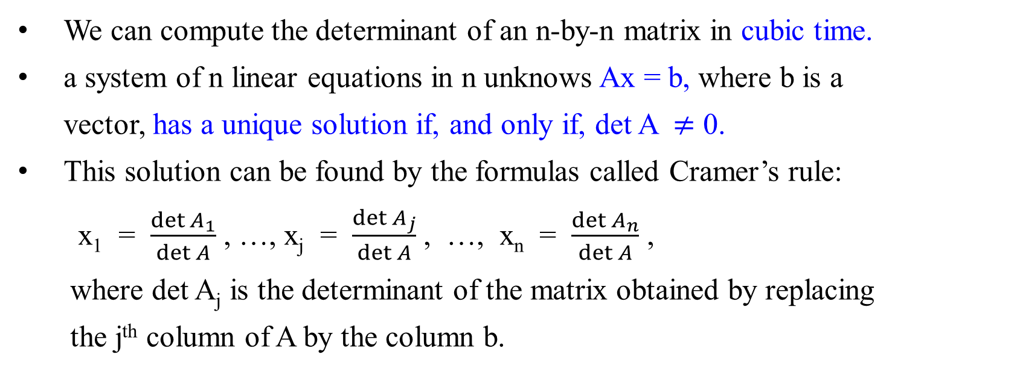
Transform-and-Conquer – Representation change
We can compute the determinant of an n-by-n matrix in cubic time.
a system of n linear equations in n unknows Ax = b, where b is a vector, has a unique solution if, and only if, det A $≠$ 0.
This solution can be found by the formulas called Cramer’s rule:
x₁ = $\frac{\det{A_{1}}}{\det{A}}$ , …, x_{j} = $\frac{\det{A_{j}}}{\det{A}}$ , …, x_{n} = $\frac{\det{A_{n}}}{\det{A}}$ ,
where det A_{j} is the determinant of the matrix obtained by replacing
the j^{th} column of A by the column b.

Slide 76
Cramer’s Rule for finding solutions for a system of three unknowns. Given
Then the values of x, y and z can be found as follows:
x = y = z =
a | b | c
d | e | f
g | h | i
x |  | j
y | = | k
z |  | m
j | b | c
k | e | f
m | h | i
a | j | c
d | k | f
g | m | i
a | b | j
d | e | k
g | h | m
a | b | c
d | e | f
g | h | i
a | b | c
d | e | f
g | h | i
a | b | c
d | e | f
g | h | i

